Slide 1
TORQUE
Translational motion:
-Center of mass in motion
-Caused by a net Force
Rotational Motion:
-Object moving around a center of mass
-Caused by a net Torque
Torque,
-The ability of a force to cause angular acceleration
-Rotational Force

Slide 2
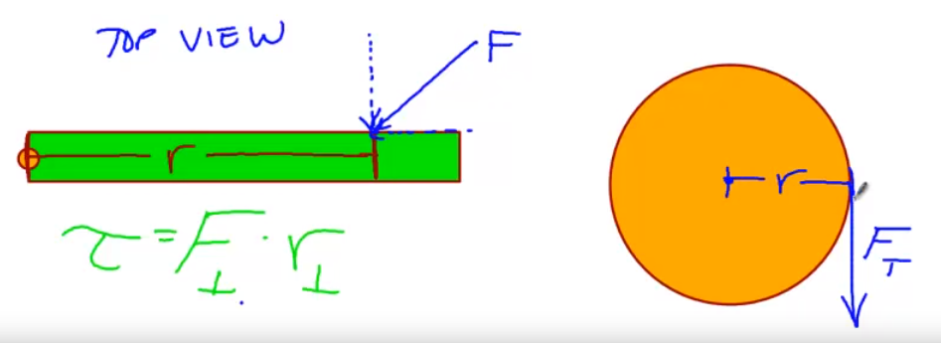
TORQUE Cont…
In this view above:
-orange dot: on the green bar represents the axis of rotation
-F=force: Force causing torque. In this case it is applied at an angel so we only care about the perpendicular component
-r= moment of arm: distance from axis of ration to where the force is applied (lever arm)
Equation for torque:
= F(r)

Slide 3
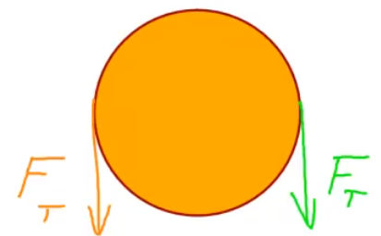
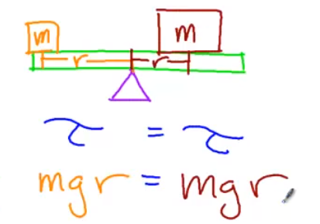
TORQUE (Rotational Equilibrium)
TORQUE:
= F(r)
Rotational Equilibrium
-If net force is zero then net torque is also zero
Example #1 : if both Forces in the diagram to the left are equal, then the object is in equilibrium
Example #2: The triangle represents the fulcrum (pivot point) for this teeter-totter. Notice the the mass on the left is smaller but has a larger moment of arm (distance from fulcrum).
In this case torque on the left balances out torque on the right
(the acting forces are just mass x gravity for each side)

Slide 4
CENTER OF MASS
*imaging a ruler sitting on a table (no fulcrum or fixed pivot point):
-if a force is applied at the center of mass (yellow circle): the entire ruler accelerates
-If the force is applied at one end of the ruler: the ruler will rotate around the COM
Force applied
If the ruler as a fixed axis of rotation (red circle) and a force is applied at the opposite end: the ruler will rotate around the pivot point (red circle)
R

Slide 5
TORQUE and Moment of Arm
Door
Hinge: Axis of rotation
Why is the door knob so far away from the axis of rotation?
*When the force is applied at the door handle there is a larger r-value (moment of arm) then if you apply the same force near the AOR (axis of rotation)
*Result: same force with larger r-value equals more torque which means greater angular acceleration…..so easier to open (rotate)
same force with smaller r-value equals less torque which means less angular acceleration………..so harder to open (rotate)

Slide 6
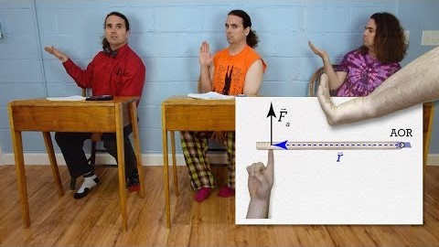
TORQUE and Right Hand Rule
*Remember that Torque is a vector quantity
Right hand Rule:
-if the applied force causes a rod to rotate counter clockwise (CCW) the Torque is positive (+)
-if the applied force causes a rod to rotate clockwise (CW) the Torque is negative (-)
*Watch this video from flipping physics regarding the right hand rule*

Slide 7
NEWTON’s 2nd Law, Rotationally
Fnet=ma
2nd Law Variables | Rotational Analog Variables
Fnet | net
M = mass | I = inertia
a=acceleration | α = rotational acceleration
= Iα
net

