Slide 1

Reviewing for the AP Exam

Slide 2
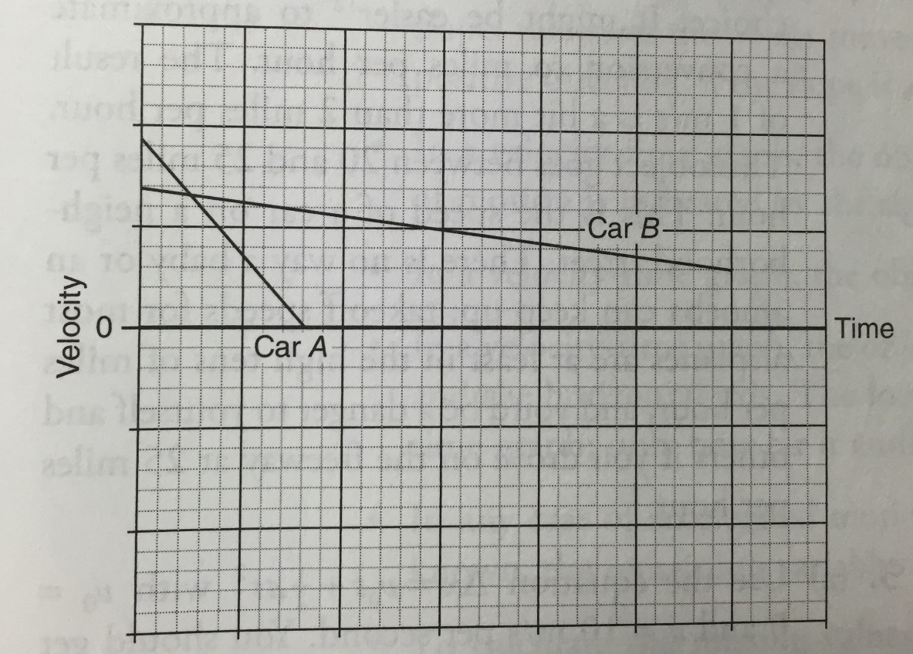
Motion in a Straight Line
The velocity-time graphs represent the motion of two cars, Car A and Car B. Justify all answers thoroughly.
1) Which car is moving faster at the start of the motion?
ANS: On a velocity-time graph, speed is read off of the vertical axis. At time = 0, Car A has a higher vertical axis reading that Car B, so Car A is moving faster

Slide 3
Motion in a Straight Line
The velocity-time graphs represent the motion of two cars, Car A and Car B. Justify all answers thoroughly.
2) Which car ends up farther from its starting point?
ANS: Displacement is determined by area under the curve. Both cars are above the horizontal line, so both are moving in the same direction. Car B has the largest area and is the farthest away.

Slide 4
Motion in a Straight Line
The velocity-time graphs represent the motion of two cars, Car A and Car B. Justify all answers thoroughly.
3) Which car experiences a greater magnitude of acceleration?
ANS: Acceleration is the slope of the velocity-time graph. Car A’s graph is steeper, so its acceleration is larger

Slide 5
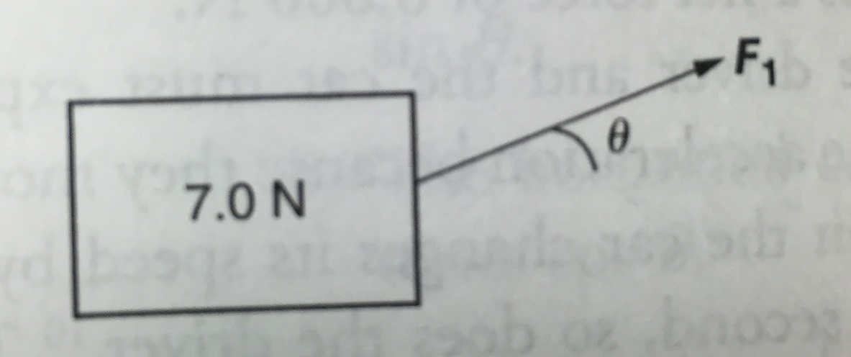
Forces and Newton’s Laws
A 7.0N block sits on a rough surface. It is being pulled by a force F₁ at an angle of 30 degrees above the horizontal. The block is initially moving to the right with speed 5 m/s. The coefficient of friction between the block and the surface is 0.20. Justify all answers.
Is it possible for the block to be slowing down? If so, give a possible value of the magnitude of F₁ that would allow the block to slow down. If not, explain why not with reference to Newton’s second law.
ANS: When an object slows down, its acceleration (and net force it experiences) is opposite the direction of its motions. Here the motion is to the right, so if the net force is to the left, choose a value such that the rightward component (F₁ cos 30) is less that the friction force acting left.

Slide 6
Forces and Newton’s Laws
A 7.0N block sits on a rough surface. It is being pulled by a force F₁ at an angle of 30 degrees above the horizontal. The block is initially moving to the right with speed 5 m/s. The coefficient of friction between the block and the surface is 0.20. Justify all answers.
2) In order to double the block’s initial speed to 10 m/s, how must the magnitude of the force F₁ change?
ANS: It does not have to change. The net force has no effect on an object’s speed. We have no idea what is happening before the problem and how the initial speed came about. The forces can all be as indicated, and the object can have any initial speed

Slide 7
Work and Energy
A 0.5 kg cart released from rest at the top of a smooth incline has gravitational energy of 6J relative to the base of the incline.
1) Calculate the cart’s speed at the bottom of the incline.
ANS: Gravitational energy is converted to kinetic energy. Kinetic energy at the bottom will be 6 J which is equal to ½ mv². Plug 0.5 in for the mass and solve for v = 4.9 m/s.
2) When the cart has rolled halfway down the incline, the cart’s gravitational potential energy will be?
ANS: 3J because gravitational potential energy is mgh. Since the h term is in the numerator and is not be squared ; cutting h in half is the cuts the whole equation in half.

Slide 8
Work and Energy
A 0.5 kg cart released from rest at the top of a smooth incline has gravitational energy of 6J relative to the base of the incline.
3) When the cart has rolled halfway down the incline, the cart’s kinetic energy will be…
ANS: 3 J, any gravitational potential energy lost must be converted to kinetic energy.
4) When the cart has rolled halfway down the incline, the cart’s speed will be …
ANS: Set 6J = ½ mv² solve for v. Because 6J will go underneath the square root, it won’t be ½ the velocity. V= 3.5 m/s
5) A 1.0 kg cart is released from rest at the top of the same incline. At the bottom, it will be moving…
ANS: The same, because energy conversion is the same mgh = ½ mv² The mass cancels and doesn’t effect the result.

Slide 9
Collisions: Impulse and Momentum
A 2 kg coconut falls from the top of a tall tree, 30 m above a person’s head. The coconut strikes and comes to rest on the person’s head. Justify all answers thoroughly.
1) Calculate the magnitude of the momentum of the coconut just before it hits the person in the head.
ANS: Momentum is mass x speed. To find the coconut’s speed us kinematics with v_{o} = 0, a = 10 m/s/s, and displacement = 30 m. V_{f} = 24 m/s and = 48 N*s
2) Calculate the magnitude and direction of the impulse experience by the coconut in colliding with the person’s head.
ANS: Impulse is the change in momentum and is in the direction of the net force experience by an object. The coconut’s momentum after colliding with the head is zero. So its change in momentum, is 48 N*s. The direction of this impulse is upward, because the net force on the coconut must be opposite its speed in order to slow it down.

Slide 10
Collisions: Impulse and Momentum
A 2 kg coconut falls from the top of a tall tree, 30 m above a person’s head. The coconut strikes and comes to rest on the person’s head. Justify all answers thoroughly.
3) The person’s head experienced a force of 10,000 N in the collision. How long was the coconut in contact with the person’s head?
ANS: Impulse = Ft. Setting 48 equal to (10,000) t we find that t is 48/10,000 of a second much less that 1/10 second.
4) In a different situation, explain how it could be possible for an identical coconut dropped from the same height to hit the person’s head, but produce less that 10,000N of force.
ANS: If the person is wearing a soft helmet, or if the coconut has a rotten spot on it somewhere, then the time of collision could be larger than before. Since t is in the denominator of the force equation, a bigger time interval of collision leads to a smaller force on the coconut.

Slide 11
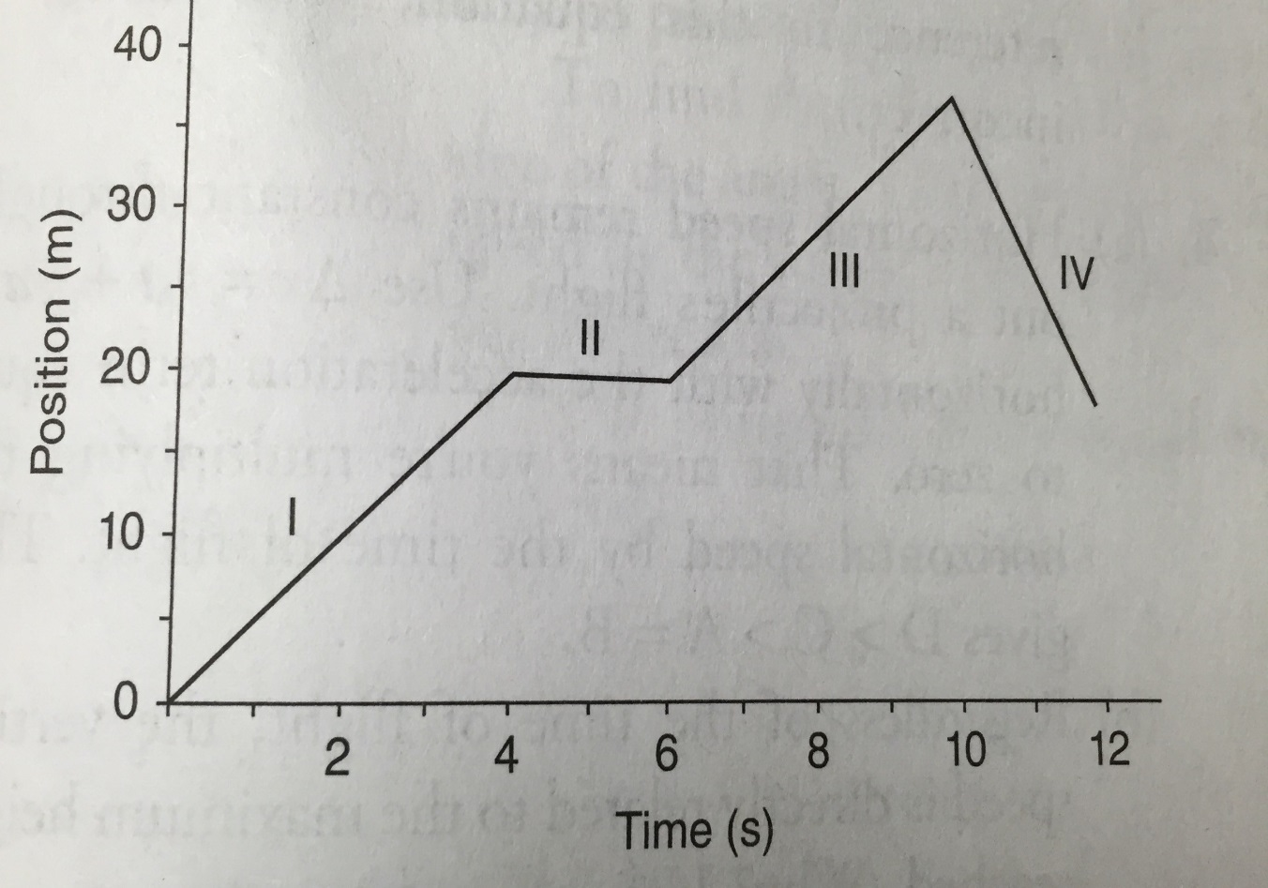
Motion in a Straight Line
The graph below is a readout of an eastward-pointing motion detector. Justify all answers thoroughly.
Rank the speed of the object in each of the four labeled regions of the graph, from fastest to slowest. If the object has the same speed in tow or more regions, indicate so in your ranking.
ANS: IV > I = III

