Slide 1
Optics

Slide 2
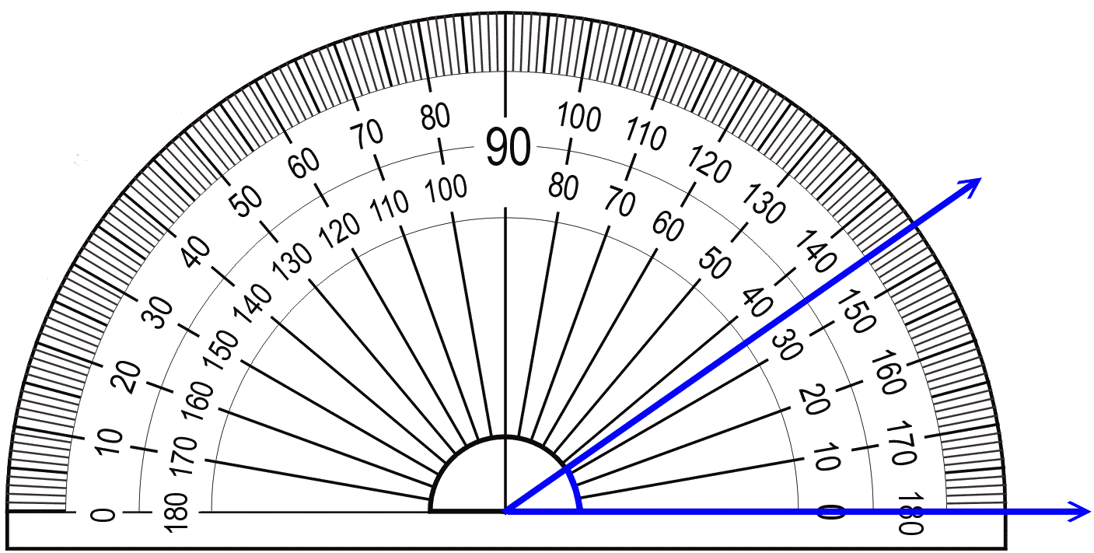
How to use a protractor
Always align the vertex of the angle with the center of the base line on the protractor.
The base of the angle aligns with the base line on the protractor. For the light ray diagrams, the base of the angle is the normal.
How many degrees is angle ABC?
A
C
B
B is the vertex of the angle.

Slide 3
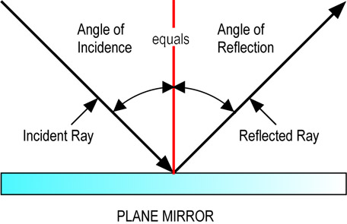
The Law of “REFLECTION”
The Law of Reflection states that- " the angle of incidence (incoming ray) equals the angle of reflection (outgoing ray)"
The law works for FLAT, PLANE surfaces only.
The angles are measured from a perpendicular line to the surface called a NORMAL.
NORMAL
What are the 4 qualities of the image?
L O S T

Slide 4
L.O.S.T.
LOST is used to describe images formed by mirrors and lenses.
L- Location: location of the image: is the image in front of or “behind” the mirror?
O- Orientation: which way the image is oriented compared to the original object: is the image upright or inverted?
S- Size: as compared to original object: is the image the same size, reduced, or magnified?
T- Type: is the image a real image or virtual image?
This is the information you were providing for part G.

Slide 5
Locating images in a Plane Mirror
reflected
mirror
incident
brain traces
LOST
1.
2.
3.
4.
object
Image of object
Behind mirror
upright
Same size
Real side
Virtual side
Virtual

Slide 6
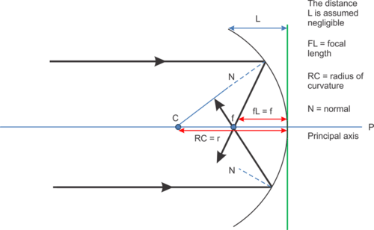
Finding the image in a mirror
We used to law of reflection to determine where an image would form in a curved mirror.
Because this mirror was curved, it was hard to find the normal line perpendicular to the tangent of the curve, so we drew it through through C.
Instead of using the law of reflection, we used the 4 easy rays.

Slide 7
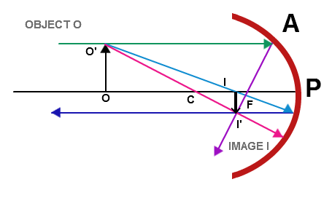
4 Easy Rays
All incident rays start from the top of the object,
Incident ray parallel to the OA. Reflect through F.
Incident ray through F. Reflect parallel to OA.
Incident and reflected ray through C.
Incident ray to apex and reflected with an equal angle.
OA

Slide 8
Image properties for mirrors
Object location | Image Location | Image Orientation | Image Size | Image Type
Plane mirror
Concave mirror Behind C
Concave mirror at C
Concave mirror between C & F
Concave mirror at F
Concave mirror between F & apex
Convex mirror

Slide 9
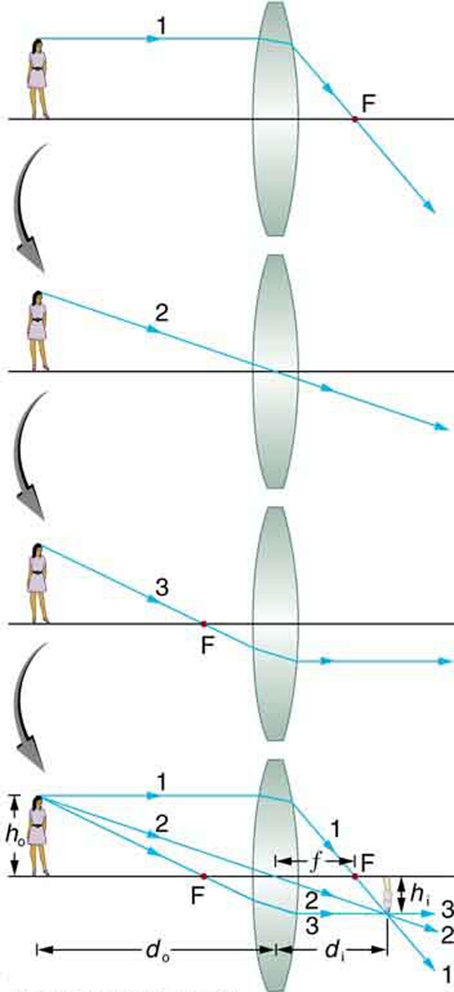
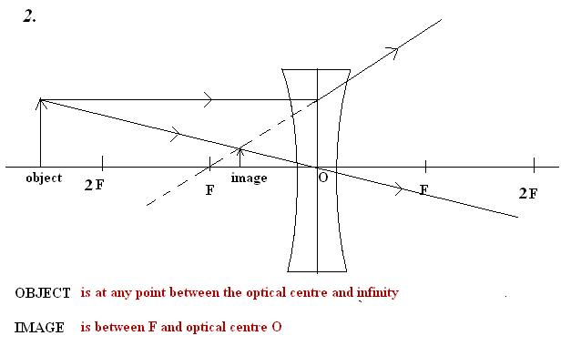
Lenses and images
Converging/Convex Lense:
-Mostly Real, Inverted, behind lense
Diverging/Convace Lense:
-Virtual, Upright (object/image on same side)

