Slide 1
Light

Slide 2
Waves…
Recall that mechanical waves require a medium to transport energy
Longitudinal the medium moves parallel to the direction of the energy
Transverse the medium moves perpendicular to the direction of the energy

Slide 3
Waves…
Electromagnetic waves are waves which require no medium to transport the disturbance, but can travel through a medium
Electromagnetic waves are transverse and are composed of a vibrating electric field perpendicular to a vibrating magnetic field

Slide 4
Notes:
Emag wave animation

Slide 5
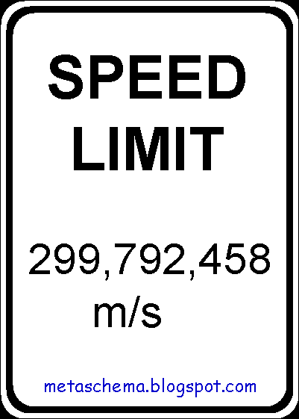
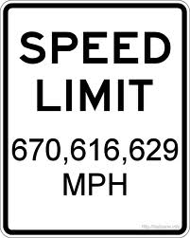
The speed of light is the same for all electromagnetic radiation.
You need to remember 300,000,000 m/s

Slide 6
Electron cloud
Electrons are located in energy levels within the electron cloud of an atom.
These energy levels represent specific quantities of energy that the electron must have within a particular atom.
Electrons cannot exist at any other energies in that particular atom.

Slide 7
Excitation
An electron absorbs some energy which causes it to “jump” to a higher energy level. This is called excitation.
E2
Energy
E1
Nucleus

Slide 8
de-excitation
The electron, preferring to be in the lower energy, drops back down to the lower energy level, releasing energy.
E2
The energy is released as photons and is proportional to the frequency of the resulting emag wave.
E1

Slide 9
Notes:
Stimulated emission animation

Slide 10
Electromagnetic Waves
Are composed of…
Photons- massless bundles of energy which have an associated frequency
Are also known as…
Light
Radiation
Light has a wave-particle duality…it has properties of both.

Slide 11
Emission Spectra
Different electron transitions from high energy levels to low energy levels result in different frequencies of electromagnetic radiation (light if we can see it)
Hot or electrified gases produce a bright line emission spectrum.
Bright line emission spectrum
Notes:
Diffraction gratings at each table

Slide 12
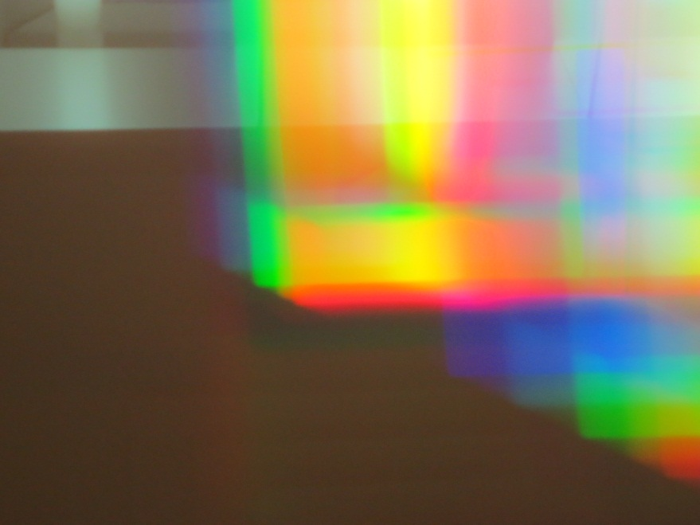
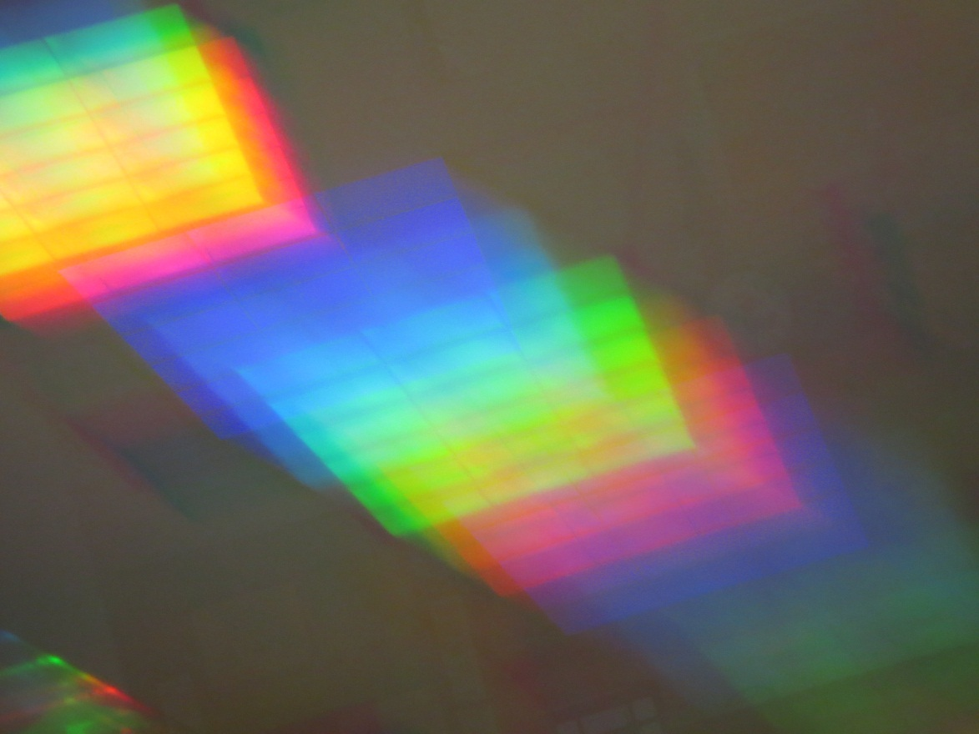
Try it…

Slide 13
Hydrogen
Helium
Carbon
Oxygen
Every element can be “fingerprinted” by its spectra.

Slide 14
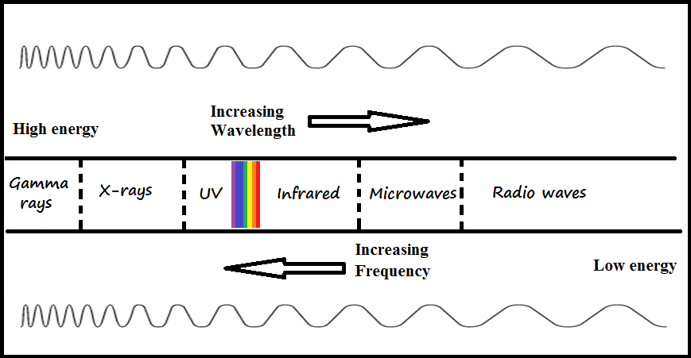
The Electromagnetic Spectrum

Slide 15
The Electromagnetic Spectrum
Radio Waves – radio, radar, TV signals

Slide 16
The Electromagnetic Spectrum
Radio Waves - radio, radar, TV signals
Microwaves - used to cook, cell phone

Slide 17
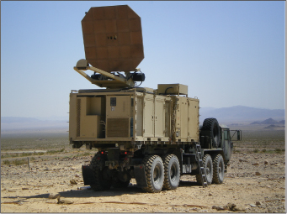

Slide 18
The Electromagnetic Spectrum
Radio Waves - radio, radar, TV signals
Microwaves - used to cook, cell phone
Infrared - “heat waves”, remote control

Slide 19
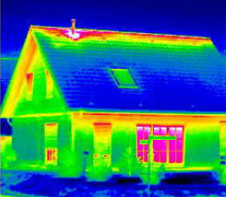
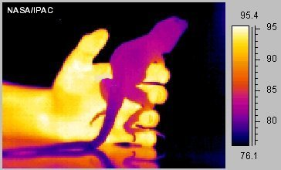

Slide 21
The Electromagnetic Spectrum
Radio Waves - radio, radar, TV signals
Microwaves - used to cook, cell phone
Infrared - “heat waves”, remote control
Visible Light - detected by your eyes

Slide 22
The Visible Spectrum
The range of electromagnetic waves extending in wavelength from about 400 to 700 namometers (10⁻⁹ m)…light.

Slide 23
The Electromagnetic Spectrum
Radio Waves - radio, radar, TV signals
Microwaves - used to cook, cell phone
Infrared - “heat waves”, remote control
Visible Light - detected by your eyes
Ultraviolet - causes sunburns, kills germs

Slide 24
The Electromagnetic Spectrum
Radio Waves - radio, radar, TV signals
Microwaves - used to cook, cell phone
Infrared - “heat waves”, remote control
Visible Light - detected by your eyes
Ultraviolet - causes sunburns, kills germs
X-rays - penetrates tissue

Slide 25
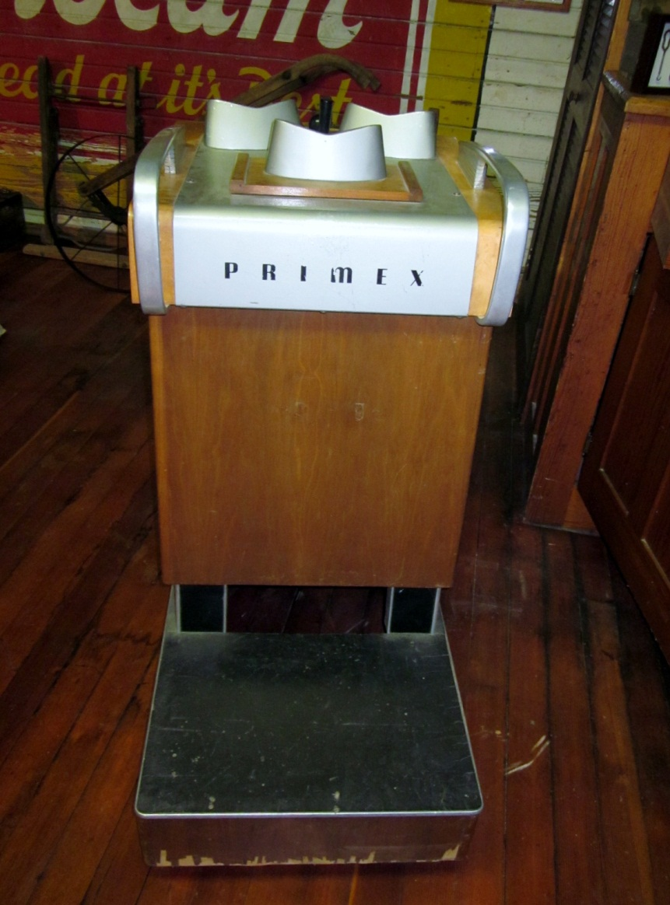
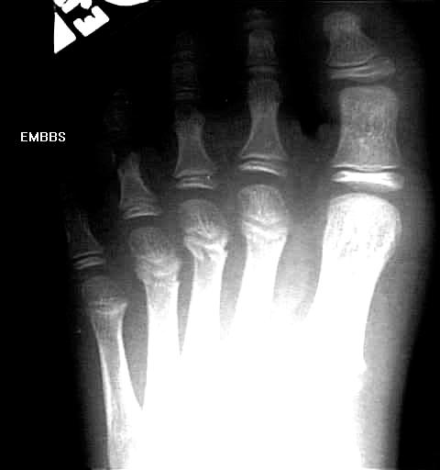
Notes:
1st through x-rays

Slide 26
The Electromagnetic Spectrum
Radio Waves - radio, radar, TV signals
Microwaves - used to cook, cell phone
Infrared - “heat waves”, remote control
Visible Light - detected by your eyes
Ultraviolet - causes sunburns, kills germs
X-rays - penetrates tissue
Gamma Rays - most energetic, cosmic rays, nuclear radiation, transition of nuclear particles

Slide 27
Emag
Notes:
Emag spectrum song

Slide 28
Transparent Materials
Transparent - materials through which light can pass in straight lines
Usually described as clear, such as window glass or water.
Also applies to a colored filter which only allows a certain color through, but clearly.

Slide 29
Opaque Materials
Opaque - materials that absorb or reflect most all light.
You cannot see though it at all

Slide 30
Translucent Materials
Translucent - materials through which light can pass, but not in straight lines resulting in objects looking blurry.
Often the light source is indistinguishable, you just see light.
A leaf, paper, skin, frosted glass.

Slide 31
Light speed changes?
As light passes through various matter, it is absorbed and re-emitted
This results in a slower observed speed through the matter than in empty space
If the matter is transparent, then the same type of light absorbed by the matter is re-emitted by the matter.

Slide 32
Light speed changes?
Since different frequency means different energy, different amounts of time are required to absorb and re-emit so the measurable speed of light in a material is frequency dependent.
Light still travels at 3 x 10⁸ m/s between molecules

Slide 33
Light speed changes?
Opaque matter: instead of re-emitting the same light, whole molecules resonate and the energy is usually converted to heat energy due to simple collisions.
Some light may be reflected as well. The frequencies reflected determine the color we see.

Slide 34
Light speed changes?
A shiny opaque object (usually metallic) is shiny/reflective due to free electrons on the surface absorbing and emitting light from the surface outward.

Slide 35
Transparency of the spectrum
Transparency depends on the specific frequency of the waves…
Glass is transparent to visible but is opaque to UV and infrared.
Are clouds transparent to visible light?
Clouds are transparent to ultraviolet light (~95%)

Slide 36
Transparency of the spectrum
Transparency depends on the specific frequency of the waves…
Your skin and bones are opaque to…
But are transparent to…
Walls are opaque to…
But transparent to…

Slide 37
Refraction
When light travels from one medium to another at an angle (not head on) the change in speed causes it to bend or REFRACT.
The different colors of visible light differ in frequency, as a result they travel at different speeds in transparent materials.
Red travels fastest and violet travels slowest. This is the cause of a rainbow as white light passes through glass or water.

Slide 38
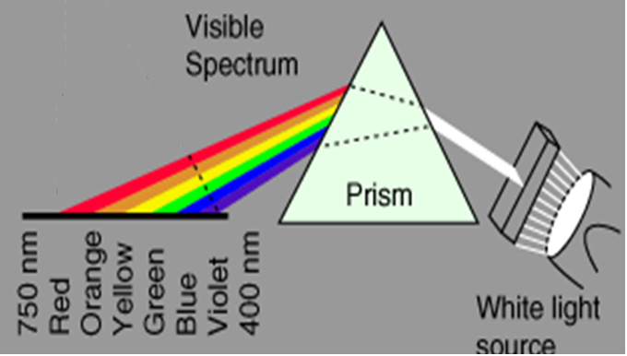
Rainbows

Slide 39
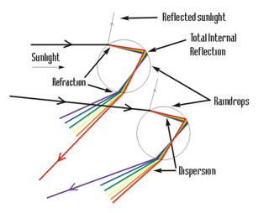
Rainbows

Slide 40
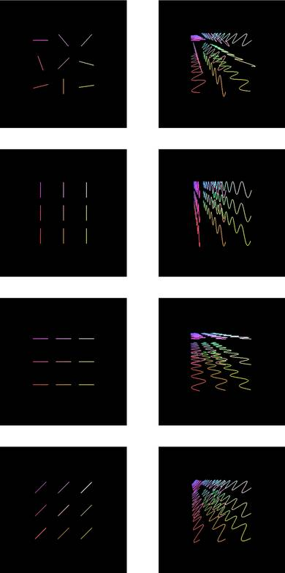
Polarization
Light produced by the sun or a light bulb has light vibrating in all planes.
A polarized filter only allows the light through that vibrates in one plane…vertical, horizontal, diagonal…
Notes:
Image http://hankblackart.com/index.php?page=home

Slide 41
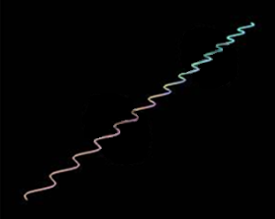
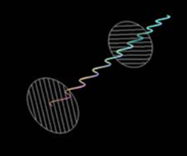
Polarization
Light reflecting off of non-metallic surfaces is naturally polarized parallel to the surface.
This horizontally polarized light, cannot pass through a vertically polarized filter…sunglasses… they remove the glare
Notes:
Image http://hankblackart.com/index.php?page=home

Slide 42
Polarization and 3-D
A typical 3-D camera is actually two cameras…each lens is spaced to simulate the spacing between typical human eyes
The film is then projected, from both perspectives, with opposite circular polarizers in front of each perspective.
The 3-D glasses have opposite circular polarized filters, each allowing one perspective through while blocking the other…just like you see normally.

