Slide 1
Frictional Forces
Factors that Affect Friction
Types of Friction
Calculating Friction

Slide 2
What is friction?
The interaction between two rough surfaces that resist the motion of the object.
No surface is perfectly smooth, so the object is slowed by interactions between the bumps and grooves.

Slide 3
What factors affect the amount of friction?
How hard the surfaces rub together.
This is also known as the….
F_{N}

Slide 4
What factors affect the amount of friction?
How rough the two surfaces are.
Coefficient of friction: a number representing how rough two surfaces are.
0 (smooth) < µ < 1 (rough)
THIS IS NOT HOW MUCH FRICTION THERE IS!!! IT IS SIMPLY HOW ROUGH THE SURFACES ARE!!! DO NOT PUT THIS ON A FREE BODY DIAGRAM.

Slide 5
Types of Friction
Static Friction
The interaction between two objects that prevents the objects from starting to move
µ_{s}
Kinetic Friction
The interaction between two objects that prevents the objects from continuing to move
µ_{k}

Slide 6
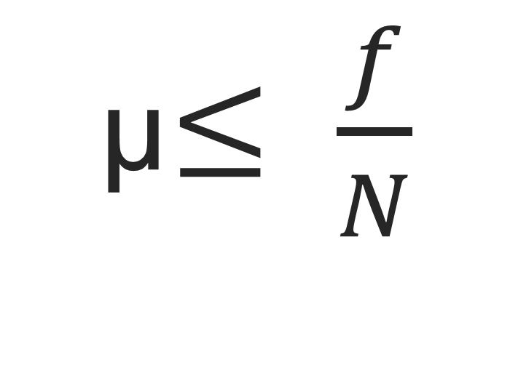
How are these variables related?
OR f ≤ µN (get it???)
f = force of friction (Newtons)
µ = coefficient of friction
N = normal force (Newtons)
The force of friction is what goes on your free-body diagram!!
µ$≤ \frac{f}{N}$

Slide 7
Why is there a less than or equal sign?
Static friction is lazy!
Static friction does the absolute minimum possible to prevent motion!
Kinetic friction always does the maximum possible to stop motion!

Slide 8
How to solve friction problems
A 20 N force is applied to the side of an 8 kg block that is sitting on a table. The block experiences a frictional force against the force that is applied.
a) What is the normal force on the block?
B) if the coefficient of friction is Uk = .4, what is the frictional force on the block (Ff)?
C) What is the net force on the block?
D) What is the acceleration on the block?

