Slide 1
Human Color Vision
Light enters through the cornea/lens and strikes the retina on the back of the eye.
The retina is composed of nerve cells called: rods and cones
Rods-respond to the intensity of the light (brightness)
Cones-respond to the frequency of light (color)
There are three types of cones: red, green, and blue

Slide 2
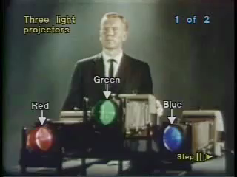

Slide 3
Primary Colors of Light

Slide 4
Light is Additive
-Light is a mixture of an infinite number of different colours, but your eyes approximate it to reddish, bluish and greenish.
-If you mix red light and green light, you can actually confuse your eyes and make it look like it's yellow light.
-Green + Red = Yellow
-Red + Blue = Magenta
-Blue + Green = Cyan
-By mixing red, green and blue light, you can make any colour of the rainbow.
-It's actually slightly more complicated but [you can convince your eyes that you're seeing] pretty much any colour of the rainbow. That's how TVs work, using red, green and blue.

Slide 5
Primary Colors of Pigment

Slide 6
But if you're dealing with printing or paints (pigment), you're doing something different……..You're taking white light which has got all the colours of the rainbow in it and you're taking colours away.
The primary colours of pigment in that sense aren't made by adding colours together, like with light, but actually subtracting, or taking colours away.
-So the primary colours with pigments are: Cyan, Magenta, Yellow
Taking red away; which actually emits a turquoise colour or cyan.
Taking green away, which is basically purple/magenta
Taking blue away which is actually yellow.
Yellow + Magenta = Red
Magenta + Cyan = Blue
Cyan + Yellow = Green
So the primary colours of pigments are cyan, magenta, (purple) and yellow. Red, yellow and blue are not any kind of primary colours at all and it's just primary school teachers trying to confuse you.

Slide 13
WHY DO HIPPOS FLY CRAZY PATTERNS AND DON’T GET ANGRY ABOUT VACUUM TUBES EATING EGGS EACH TUESDAY, AND HAVE YOU HEARD... ORANGES ARE DRY?

