Slide 1
College Physics: Explore and Apply
Second Edition
Chapter 4 Clickers
Applying Newton’s Laws
Prepared by
Elliot Mylott
University of Portland
Copyright © 2019 Pearson Education, Inc. All Rights Reserved
Notes:
If this PowerPoint presentation contains mathematical equations, you may need to check that your computer has the following installed:
1) MathType Plugin
2) Math Player (free versions available)
3) NVDA Reader (free versions available)

Slide 2
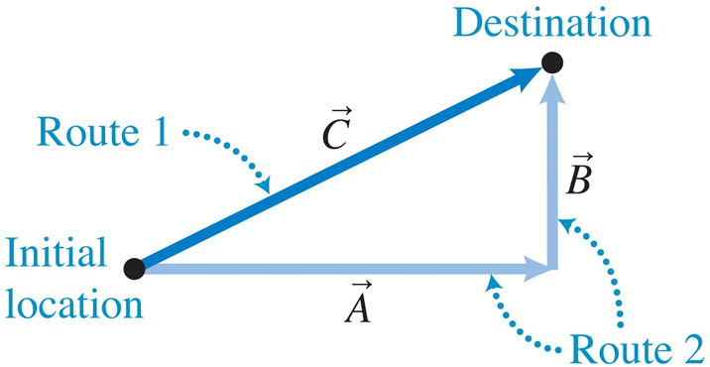
Which of the Following Statements Is Correct About Graphical Vector Addition? Be Prepared to Explain Your Reasoning.
a. Vector A plus vector C equals vector B.
b. Vector C is always shorter than the lengths of A and B combined, no matter the angle between A and C.
c. A and B must be perpendicular to each other for C to be an equivalent displacement.
d. Vector B plus vector A is an equivalent displacement to vector A plus vector B.
Notes:
Answer: D) Vector B plus vector A is an equivalent displacement to vector A plus vector B.
Note: B and C are both difficult—B is ONLY incorrect if A and B are parallel and C is technically incorrect but for practical purposes we want them perpendicular, so this question is aiming at a rich discussion among possible answers.

Slide 3
Which of the Following Statements Is Correct About Graphical Vector Addition? Be Prepared to Explain Your Reasoning.
a. Vector A plus vector C equals vector B.
b. Vector C is always shorter than the lengths of A and B combined, no matter the angle between A and C.
c. A and B must be perpendicular to each other for C to be an equivalent displacement.
d. Vector B plus vector A is an equivalent displacement to vector A plus vector B.
Notes:
Answer: D) Vector B plus vector A is an equivalent displacement to vector A plus vector B.
Note: B and C are both difficult—B is ONLY incorrect if A and B are parallel and C is technically incorrect but for practical purposes we want them perpendicular, so this question is aiming at a rich discussion among possible answers.

Slide 4
A Force of 1 N Pulls to the East While a Force of 1 N Pulls to the North. What Can We Say About the Vector Sum of These Two Forces?
a. We cannot find their vector sum because they point in different directions.
b. Their vector sum is 2 N in magnitude.
c. Their vector sum points northeast (45 degrees from both north and east).
d. Their vector sum cannot be determined with the information given.
Notes:
Answer: C) Their vector sum points northeast (45 degrees from both north and east).

Slide 5
A Force of 1 N Pulls to the East While a Force of 1 N Pulls to the North. What Can We Say About the Vector Sum of These Two Forces?
a. We cannot find their vector sum because they point in different directions.
b. Their vector sum is 2 N in magnitude.
c. Their vector sum points northeast (45 degrees from both north and east).
d. Their vector sum cannot be determined with the information given.
Notes:
Answer: C) Their vector sum points northeast (45 degrees from both north and east).

Slide 6
A Force of Magnitude 3 N Points in the +x Direction and a Force of 4 N Points in the −y Direction. Which of the Following Statements Is Not Correct?
a. The magnitude of the vector sum of the two forces is 5 N.
b. The vector sum will be between the +x and −y axes (fourth quadrant).
c. The angle the vector sum makes from the y-axis can be
found by
d. 3 N equals the magnitude of the vector sum times the cosine of the angle between the x-axis and the vector sum.
Notes:
Answer: C) The angle the vector sum makes from the y-axis can be found by tan⁻¹(4/3).

Slide 7
A Force of Magnitude 3 N Points in the +x Direction and a Force of 4 N Points in the −y Direction. Which of the Following Statements Is Not Correct?
a. The magnitude of the vector sum of the two forces is 5 N.
b. The vector sum will be between the +x and −y axes (fourth quadrant).
c. The angle the vector sum makes from the y-axis can be
found by
d. 3 N equals the magnitude of the vector sum times the cosine of the angle between the x-axis and the vector sum.
Notes:
Answer: C) The angle the vector sum makes from the y-axis can be found by tan⁻¹(4/3).

Slide 8
Which Statement Is Correct About Positive Versus Negative Scalar Components?
a. The scalar component is always positive because it is not a vector.
b. If the vector component points along the positive axis, then the scalar component is positive.
c. If the vector component points along the positive axis, then the scalar component is negative.
d. If the vector component points in the opposite direction of the positive axis, then the scalar component is positive.
Notes:
Answer: B) If the vector component points along the positive axis, then the scalar component is positive.

Slide 9
Which Statement Is Correct About Positive Versus Negative Scalar Components?
a. The scalar component is always positive because it is not a vector.
b. If the vector component points along the positive axis, then the scalar component is positive.
c. If the vector component points along the positive axis, then the scalar component is negative.
d. If the vector component points in the opposite direction of the positive axis, then the scalar component is positive.
Notes:
Answer: B) If the vector component points along the positive axis, then the scalar component is positive.

Slide 10
Which of the Following Statements About Using Newton’s Second Law in Component Form Is Correct?
a. A force diagram helps to visualize the magnitude and direction of the sum of the forces.
b. Each force needs to be broken into components along the x- and y-axes.
c. Forces along the x- and y-axes must be summed separately.
d. All of the above are correct.
Notes:
Answer: D) All of the above are correct.

Slide 11
Which of the Following Statements About Using Newton’s Second Law in Component Form Is Correct?
a. A force diagram helps to visualize the magnitude and direction of the sum of the forces.
b. Each force needs to be broken into components along the x- and y-axes.
c. Forces along the x- and y-axes must be summed separately.
d. All of the above are correct.
Notes:
Answer: D) All of the above are correct.

Slide 12
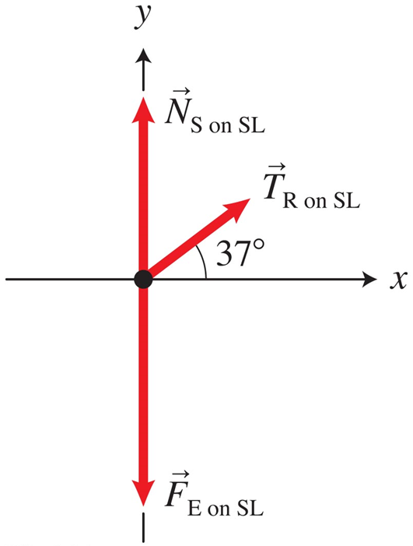
What Can We Conclude About the Sum of the Forces Based on the Force Diagram and the Context of Pulling a Sled Horizontally?
a. The sum of the forces has a component in the +x direction.
b. The sum of the forces has a component in the +y direction.
c. The sum of the forces has a component in the −x direction.
d. The sum of the forces has a component in the −y direction.
Notes:
Answer: A) The sum of the forces has a component in the +x direction.
Note: They can’t rule out B or D without realizing there can't be acceleration along the y-axis for horizontal motion—this is meant to tease out that discussion.

Slide 13
What Can We Conclude About the Sum of the Forces Based on the Force Diagram and the Context of Pulling a Sled Horizontally?
a. The sum of the forces has a component in the +x direction.
b. The sum of the forces has a component in the +y direction.
c. The sum of the forces has a component in the −x direction.
d. The sum of the forces has a component in the −y direction.
Notes:
Answer: A) The sum of the forces has a component in the +x direction.
Note: They can’t rule out B or D without realizing there can't be acceleration along the y-axis for horizontal motion—this is meant to tease out that discussion.

Slide 14
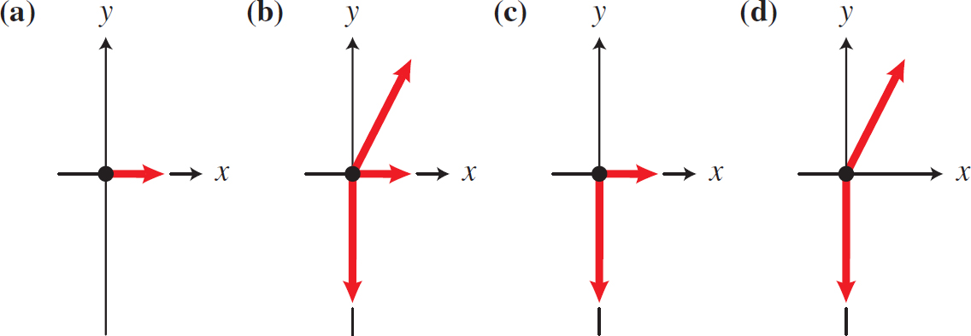
Which Force Diagram Best Represents a Child on a Swing?
a. Force diagram A
b. Force diagram B
c. Force diagram C
d. Force diagram D
Notes:
Answer: D) Force diagram D

Slide 15
Which Force Diagram Best Represents a Child on a Swing?
a. Force diagram A
b. Force diagram B
c. Force diagram C
d. Force diagram D
Notes:
Answer: D) Force diagram D

Slide 16
Which of the Following Statements Is Correct About Static Friction?
a. Static friction is never present when an object is moving.
b. Static friction always has the same magnitude for a given object on a given surface no matter what external forces are applied.
c. Static friction is always parallel to the object-surface interface.
d. The magnitude of the static friction force depends solely on which horizontal external forces are acting on the object.
Notes:
Answer: C) Static friction is always parallel to the object-surface interface.

Slide 17
Which of the Following Statements Is Correct About Static Friction?
a. Static friction is never present when an object is moving.
b. Static friction always has the same magnitude for a given object on a given surface no matter what external forces are applied.
c. Static friction is always parallel to the object-surface interface.
d. The magnitude of the static friction force depends solely on which horizontal external forces are acting on the object.
Notes:
Answer: C) Static friction is always parallel to the object-surface interface.

Slide 18
Which of the Following Statements Is Correct About the Magnitude of the Static Friction Force Between an Object and a Surface?
a. Static friction depends on the mass of the object.
b. Static friction depends on the shape of the object.
c. Static friction depends on what the object is made of but not what the surface is made of.
d. None of the above is correct.
Notes:
Answer: D) None of the above is correct.
Note: “A” is going to be a popular answer—this question is to emphasize what is learned from testing experiment Table 4.3.

Slide 19
Which of the Following Statements Is Correct About the Magnitude of the Static Friction Force Between an Object and a Surface?
a. Static friction depends on the mass of the object.
b. Static friction depends on the shape of the object.
c. Static friction depends on what the object is made of but not what the surface is made of.
d. None of the above is correct.
Notes:
Answer: D) None of the above is correct.
Note: “A” is going to be a popular answer—this question is to emphasize what is learned from testing experiment Table 4.3.

Slide 20
Which of the Following Statements Is Correct About Kinetic Friction?
a. Our model works for rolling objects.
b. Our model works for objects moving at very high speeds.
c. Our model works for rigid surfaces and objects.
d. Our model depends on the mass of the object.
Notes:
Answer: C) Our model works for rigid surfaces and objects.
Note: This is a reading/review question, but also gets at the tricky “mass dependence” issue.

Slide 21
Which of the Following Statements Is Correct About Kinetic Friction?
a. Our model works for rolling objects.
b. Our model works for objects moving at very high speeds.
c. Our model works for rigid surfaces and objects.
d. Our model depends on the mass of the object.
Notes:
Answer: C) Our model works for rigid surfaces and objects.
Note: This is a reading/review question, but also gets at the tricky “mass dependence” issue.

Slide 22
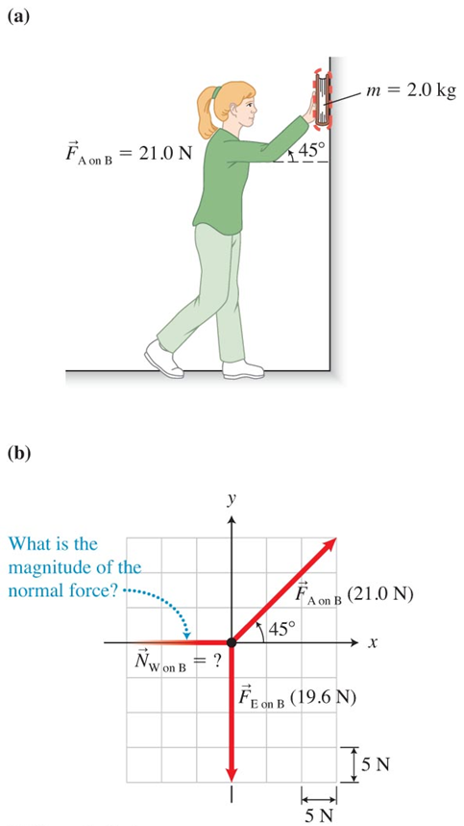
For the Situation Shown in the Diagram, Assume the Box Is Sliding Upward Along the Wall at a Constant Velocity. Which Equation(s) Will Help You Solve the Problem?
a.
b.
c.
d.
e. All of the above
Notes:
Answer: E) All of the above

Slide 23
For the Situation Shown in the Diagram, Assume the Box Is Sliding Upward Along the Wall at a Constant Velocity. Which Equation(s) Will Help You Solve the Problem?
a.
b.
c.
d.
e. All of the above
Notes:
Answer: E) All of the above

Slide 24
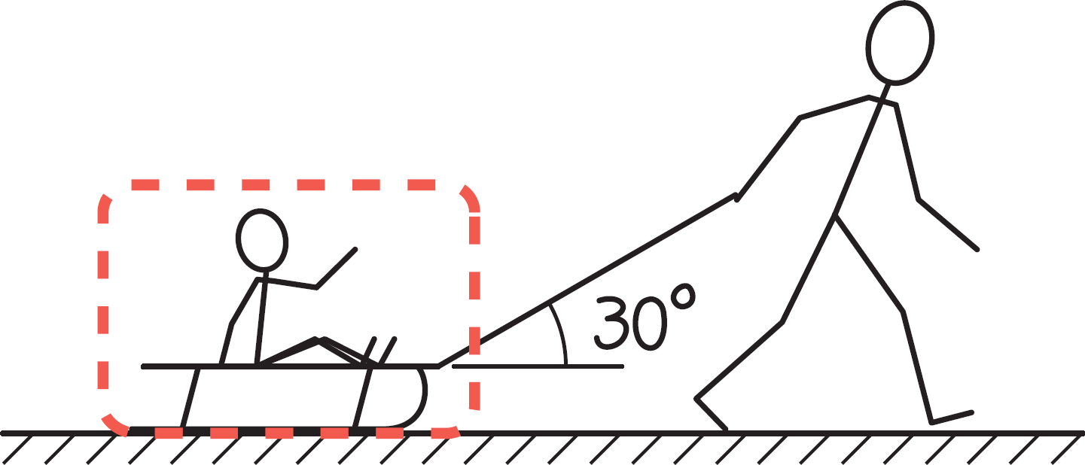
A Child on a Sled Is Being Pulled to the Right by a Rope at an Angle of 30°. What Can We Say About the Frictional Force on the Sled?
a.
b.
c.
d. All of these options are wrong because static friction acts on the sled, not kinetic.
Notes:
Answer: A) f_{k} < μ_{k} W_{sled + child}
Note: The frictional force is less than μ_{k} W_{sled + child} because there is a component of tension in the positive direction, which means the normal force is less than the weight of the child and sled.

Slide 25
A Child on a Sled Is Being Pulled to the Right by a Rope at an Angle of 30°. What Can We Say About the Frictional Force on the Sled?
a.
b.
c.
d. All of these options are wrong because static friction acts on the sled, not kinetic.
Notes:
Answer: A) f_{k} < μ_{k} W_{sled + child}
Note: The frictional force is less than μ_{k} W_{sled + child} because there is a component of tension in the positive direction, which means the normal force is less than the weight of the child and sled.

Slide 26
For a Child Sliding down the Water Slide, Which of the Following Is a Reason That We Tilt the x-Axis to Be Parallel to the Slide?
a. We tilt the x-axis so that the acceleration is zero along the y-axis.
b. We tilt the x-axis so that we have to find fewer vector components for the forces exerted on the child.
c. We tilt the x-axis so that we don’t have to break the gravitational force that the Earth exerts on the person into vector components.
d. Both A and B are correct.
Notes:
Answer: A) We tilt the x-axis so that the acceleration is zero along the y-axis.
Note: This question is for enforcing the idea that there might be more components to find but it is still worth doing this because of “A.”

Slide 27
For a Child Sliding down the Water Slide, Which of the Following Is a Reason That We Tilt the x-Axis to Be Parallel to the Slide?
a. We tilt the x-axis so that the acceleration is zero along the y-axis.
b. We tilt the x-axis so that we have to find fewer vector components for the forces exerted on the child.
c. We tilt the x-axis so that we don’t have to break the gravitational force that the Earth exerts on the person into vector components.
d. Both A and B are correct.
Notes:
Answer: A) We tilt the x-axis so that the acceleration is zero along the y-axis.
Note: This question is for enforcing the idea that there might be more components to find but it is still worth doing this because of “A.”

Slide 28
A Pulley Can Do the Following (If It Has Negligible Mass and Friction):
a. Change the magnitude of the acceleration of objects attached to a rope going around the pulley.
b. Change the direction of the acceleration of objects attached to a rope going around the pulley.
c. Both A and B are correct.
d. Neither A nor B is correct.
Notes:
Answer: B) Change the direction of the acceleration of objects attached to a rope going around the pulley.
Note: This is important for talking about the assumptions for pulleys.

Slide 29
A Pulley Can Do the Following (If It Has Negligible Mass and Friction):
a. Change the magnitude of the acceleration of objects attached to a rope going around the pulley.
b. Change the direction of the acceleration of objects attached to a rope going around the pulley.
c. Both A and B are correct.
d. Neither A nor B is correct.
Notes:
Answer: B) Change the direction of the acceleration of objects attached to a rope going around the pulley.
Note: This is important for talking about the assumptions for pulleys.

Slide 30
If Our Hypothesis That Horizontal and Vertical Motions Are Independent of Each Other Is Correct, What Will Be the Prediction for the Outcome of the Following Testing Experiment?
a. The ball that is dropped will land before the ball that is shot horizontally.
b. The two balls will land at the same time.
c. The ball that is dropped will land after the ball that is shot horizontally.
d. It is impossible to determine this based on our prediction.
Notes:
Answer: B) The two balls will land at the same time.

Slide 31
If Our Hypothesis That Horizontal and Vertical Motions Are Independent of Each Other Is Correct, What Will Be the Prediction for the Outcome of the Following Testing Experiment?
a. The ball that is dropped will land before the ball that is shot horizontally.
b. The two balls will land at the same time.
c. The ball that is dropped will land after the ball that is shot horizontally.
d. It is impossible to determine this based on our prediction.
Notes:
Answer: B) The two balls will land at the same time.

Slide 32
Why Do We Need to Resolve the Initial Velocity of a Projectile into Components When We Analyze Situations Involving Projectiles?
a. Because the x- and y-motions are independent of each other.
b. Because velocity is a vector and vector equations must be dealt with in component form.
c. Because we use it to relate to the displacement, which is a vector.
d. All of the above are correct.
Notes:
Answer: D) All of the above are correct.

Slide 33
Why Do We Need to Resolve the Initial Velocity of a Projectile into Components When We Analyze Situations Involving Projectiles?
a. Because the x- and y-motions are independent of each other.
b. Because velocity is a vector and vector equations must be dealt with in component form.
c. Because we use it to relate to the displacement, which is a vector.
d. All of the above are correct.
Notes:
Answer: D) All of the above are correct.

Slide 34
Which of the Following Statements Is Not Correct About a Projectile at the Peak of Its Trajectory?
a. The velocity of the projectile is tangent to the object’s trajectory.
b. The velocity of the projectile is perpendicular to the object’s acceleration.
c. The magnitude of the projectile’s velocity at the peak is equal to the magnitude of its initial velocity.
d. The object has zero velocity in the vertical direction.
Notes:
Answer: C) The magnitude of the projectile’s velocity at the peak is equal to the magnitude of its initial velocity.

Slide 35
Which of the Following Statements Is Not Correct About a Projectile at the Peak of Its Trajectory?
a. The velocity of the projectile is tangent to the object’s trajectory.
b. The velocity of the projectile is perpendicular to the object’s acceleration.
c. The magnitude of the projectile’s velocity at the peak is equal to the magnitude of its initial velocity.
d. The object has zero velocity in the vertical direction.
Notes:
Answer: C) The magnitude of the projectile’s velocity at the peak is equal to the magnitude of its initial velocity.

Slide 36
Antilock Breaks Are Important Because:
a. the kinetic friction force is greater than the maximal static friction force, so preventing the tire from skidding allows for more stopping force.
b. when the wheels are turning and the car is slowing down, the static friction force is in the forward direction unless the car skids.
c. skidding does not provide a friction force against the direction of motion.
d. None of the above is correct.
Notes:
Answer: D) None of the above is correct.

Slide 37
Antilock Breaks Are Important Because:
a. the kinetic friction force is greater than the maximal static friction force, so preventing the tire from skidding allows for more stopping force.
b. when the wheels are turning and the car is slowing down, the static friction force is in the forward direction unless the car skids.
c. skidding does not provide a friction force against the direction of motion.
d. None of the above is correct.
Notes:
Answer: D) None of the above is correct.

Slide 38
Which of the Following Statements Is Not Correct About the Static Friction Force Between a Car’s Tires and the Road?
a. There is no static friction force unless the car tires skid.
b. The static friction force is zero if the car is moving at constant velocity (assuming no force of drag between air and the car).
c. The static friction force is in the positive direction if the tires are rotating faster and faster.
d. The static friction is in the negative direction if the tires are rotating slower and slower.
Notes:
Answer: A) There is no static friction force unless the car tires skid.

Slide 39
Which of the Following Statements Is Not Correct About the Static Friction Force Between a Car’s Tires and the Road?
a. There is no static friction force unless the car tires skid.
b. The static friction force is zero if the car is moving at constant velocity (assuming no force of drag between air and the car).
c. The static friction force is in the positive direction if the tires are rotating faster and faster.
d. The static friction is in the negative direction if the tires are rotating slower and slower.
Notes:
Answer: A) There is no static friction force unless the car tires skid.

Slide 40
What Can Be Concluded by Looking at the x- and y-Equations for an Unknown Process?
x-equation:
y-equation:
a. The object has a nonzero acceleration along the y-axis.
b. The object is moving in the positive x-direction.
c. The object has an applied force of 200 N that is not along either the x- or y-axis.
d. None of the above can be concluded.
Notes:
Answer: C) The object has an applied force of 200 N that is not along either the x- or y-axis.

Slide 41
What Can Be Concluded by Looking at the x- and y-Equations for an Unknown Process?
x-equation:
y-equation:
a. The object has a nonzero acceleration along the y-axis.
b. The object is moving in the positive x-direction.
c. The object has an applied force of 200 N that is not along either the x- or y-axis.
d. None of the above can be concluded.
Notes:
Answer: C) The object has an applied force of 200 N that is not along either the x- or y-axis.

Slide 42
Copyright
This work is protected by United States copyright laws and is provided solely for the use of instructors in teaching their courses and assessing student learning. Dissemination or sale of any part of this work (including on the World Wide Web) will destroy the integrity of the work and is not permitted. The work and materials from it should never be made available to students except by instructors using the accompanying text in their classes. All recipients of this work are expected to abide by these restrictions and to honor the intended pedagogical purposes and the needs of other instructors who rely on these materials.

